Slide 1


Introduction to Large
Language
Models

Slide 2

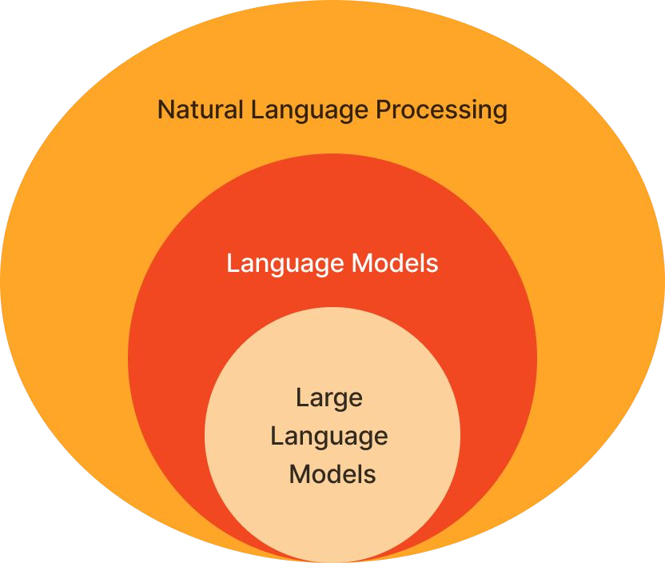
Accuracy and effectiveness has hit a tipping point
Many new use cases are unlocked!
Accessible by all.
Readily available data and tooling
Large datasets.
Open-sourced model options.
Requires powerful GPUs, but are available on the cloud.
.

Slide 3

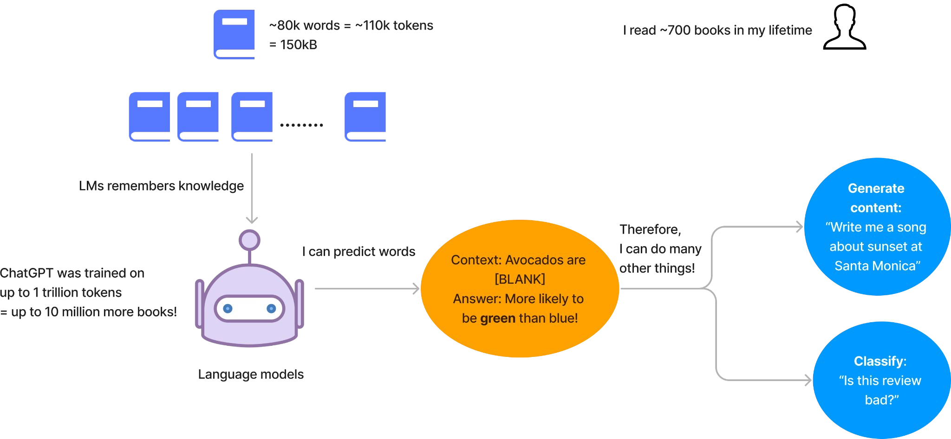

What is an LLM?
It’s a large language model trained on enormous data

Slide 4
How to consider the right LLM
1
Model Quality
2
Serving Cost
3
Customizability

Slide 5
NLP Usecases:
Sentiment analysis: product reviews
Other use cases
Semantic similarity
This book was terrible and went
on and on about…
Negative
Literature search.
Database querying.
Question-Answer matching.
Translation
I like this book.
Summarization
Me gusta este libro.
Clinical decision support.
News article sentiments.
Legal proceeding summary.
Question answering: chatbots
What’s the best sciﬁ book ever?
Text classiﬁcation
It really depends on your
preferences. Some of the top-rated ones include…
Customer review sentiments.
Genre/topic classiﬁcation.
©2023 Databricks Inc. — All rights reserved

Slide 6
Some useful NLP deﬁnitions
The moon, Earth's only natural satellite, has been a subject of fascination and wonder for thousands of years.
Token
Basic building block
Sequence
Sequential list of tokens
Vocabulary
Complete list of tokens
The
Moon
• ,
Earth’s
Only
…..
years
The moon,
Earth’s only natural satellite
Has been a subject of
….
Thousands of years
{
1:"The",
569:"moon",
122: ",",
430:"Earth",
50:"**’s",
…}
©2023 Databricks Inc. — All rights reserved

Slide 7
Transformers
Attention and the Transformer Architecture

Slide 8
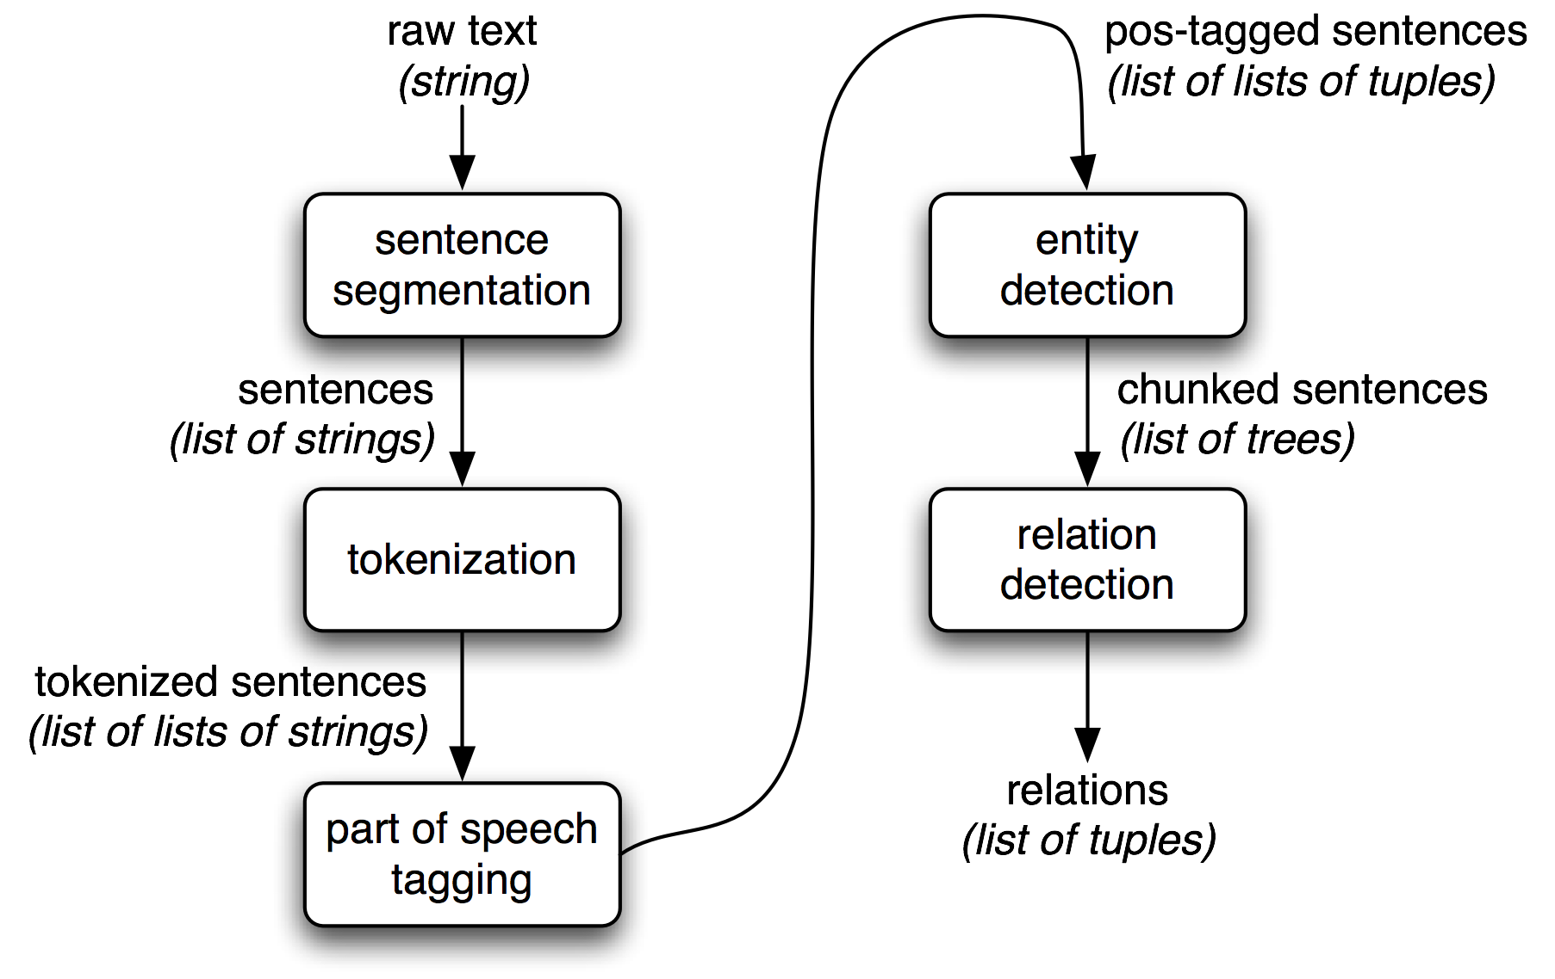
NLP other use cases…
Speech recognition
Image caption generation
Image generation from text.

Slide 9
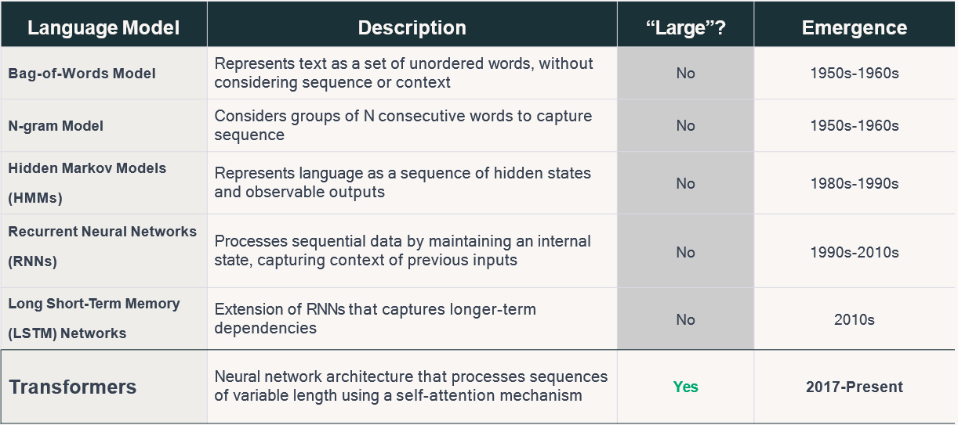
What is a Large Language Model?

Slide 10
DISADVANTAGES OF RNN AND LSTM OVER TRANSFORMER ARCHITECTURE ..
https://ai.stackexchange.com/questions/20075/why-does-the-transformer-do-better-than-rnn-and-lstm-in-long-range-context-depen

Slide 11
Typical dimension sizes: 768, 1024, 4096
What is word embedding
Represent words with vectors
“puppy”
Embedding function
[0.2, 1.5, 0.6 …. 0.6]
word/token
Word embedding/vector
Pre-trained module (eg. word2vec model)
When done well, similar words will be closer in these embedding/vector spaces.
Reference:://htpps://www.geeksforgeeks.org/word-embeddings-in-nlp/

Slide 12
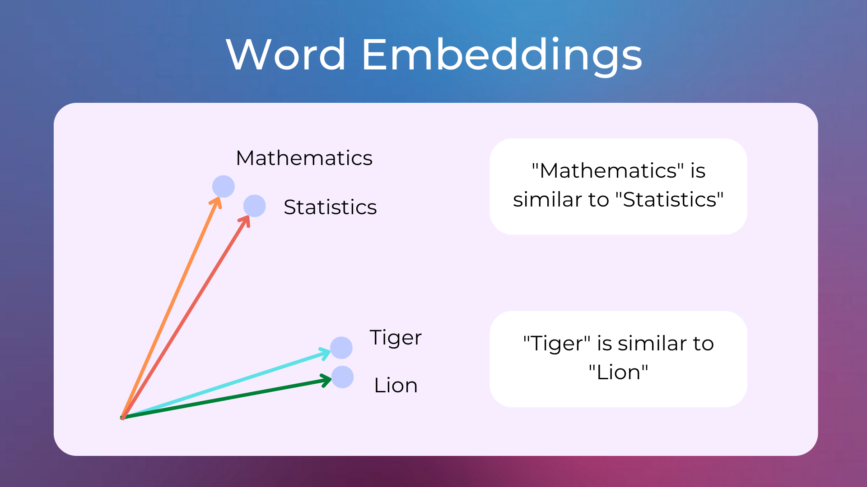

Slide 13
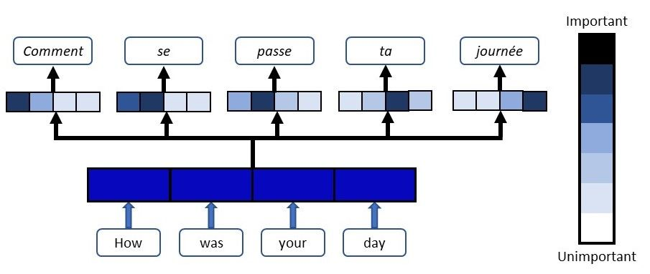
Thee attention mechanism measures how words interrelate

Slide 14
Attention is (not) all you need
A new type of deep learning architecture
Attention is a linear, matrix operation.
Input token embedding vector
Where is the neural network?
Attention
Let’s look at The Transformer Block
Fully Connected Neural Network
Normalization and Residual Connection
Output vector

Slide 15

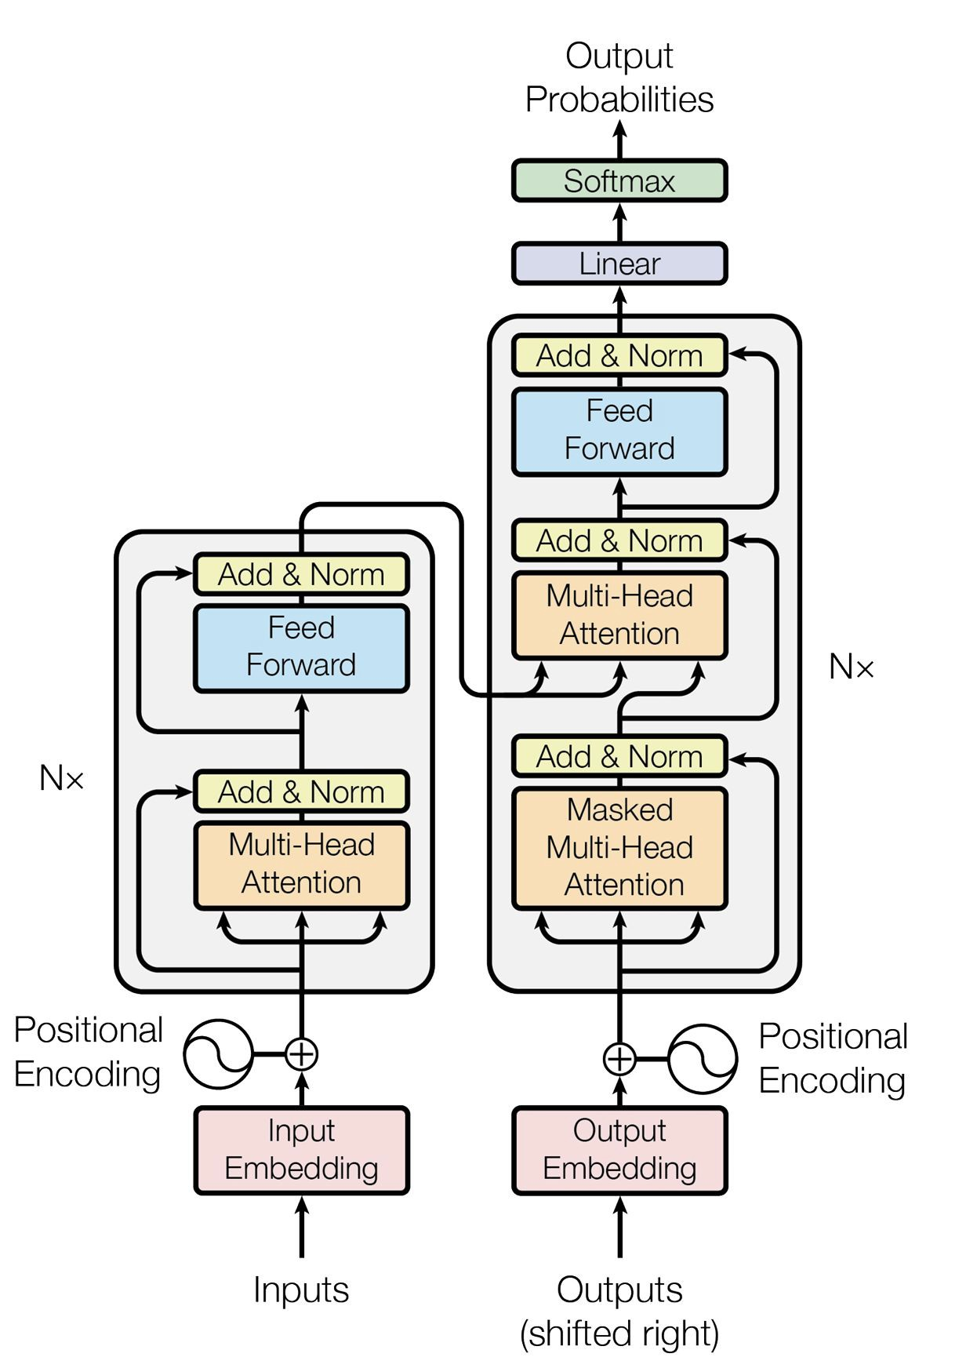
Deﬁning Features:
Two sets of transformer blocks
Encoder blocks
Decoder blocks
Cross-attention
Typical Uses:
Translation
Conversion

Slide 16
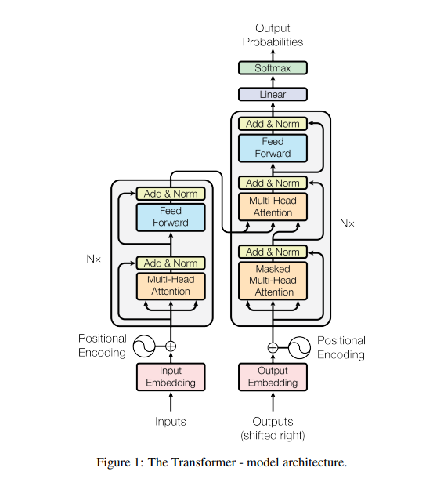

Slide 17
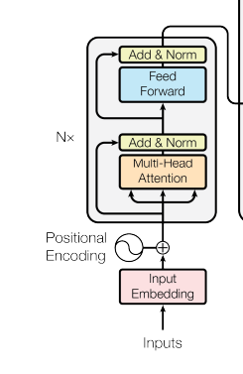
Transformer blocks
Process input vectors with attention to enrich
Add nonlinear transformation with NN
Apply enriched vectors to select the correct token from the model’s vocabulary

Slide 18
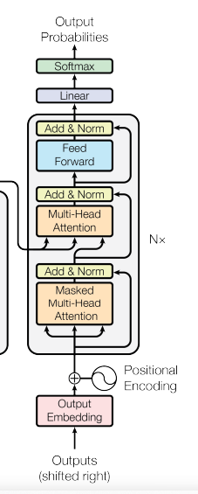
The role of
attention
Measure the importance and relevance of each word relative to each other
Allow for the building-up of enriched vectors with more context and logic

Slide 19
Role of Feed forward network
Adding nonlinearity to understanding the input.
Use the information gathered from the attention stage for each element in the sequence and translate it to a further enriched state
Allow for nonlinear transformations of each element in the sequence and builds upon itself in subsequent layers

Slide 20
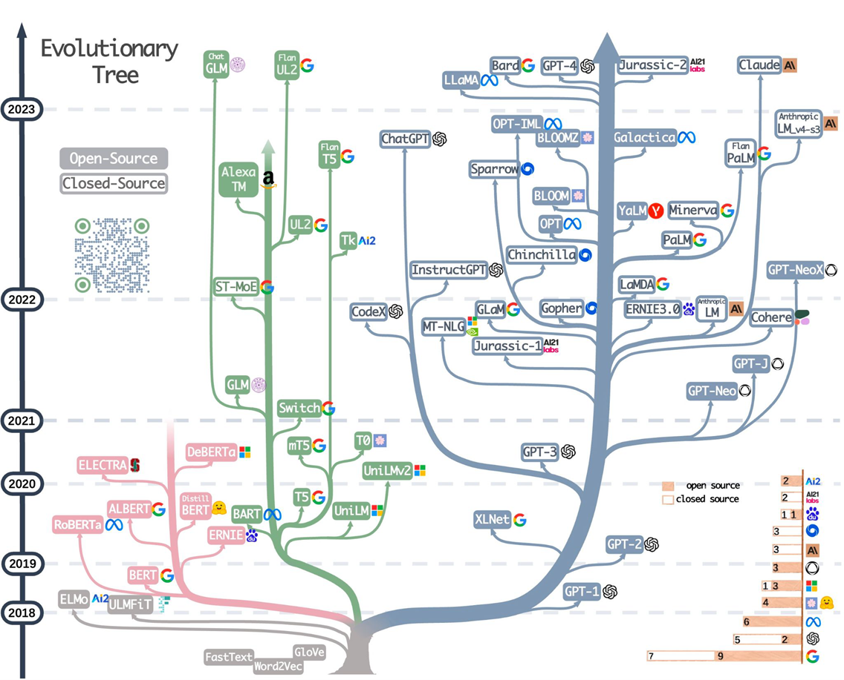

Slide 21
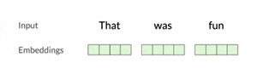
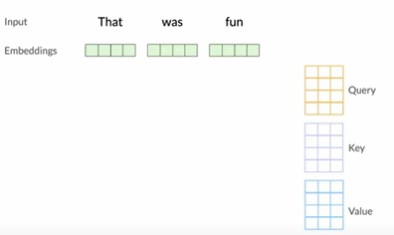
ATTENTION MECHANISM

Slide 22
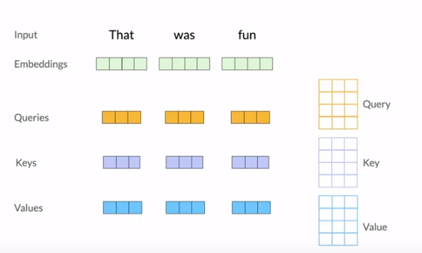

Slide 23
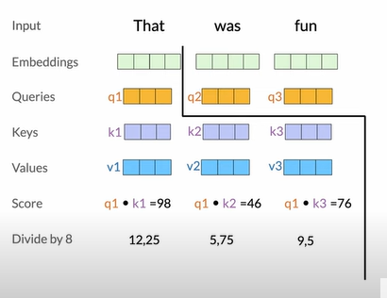

Slide 25
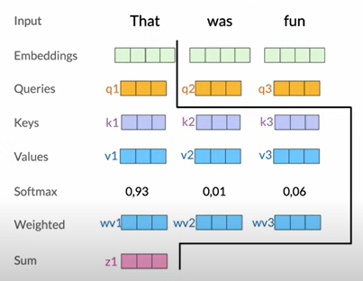

Slide 26
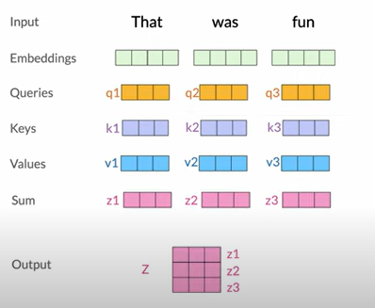
These steps are been done 8 times , giving 8 different outputs

Slide 27
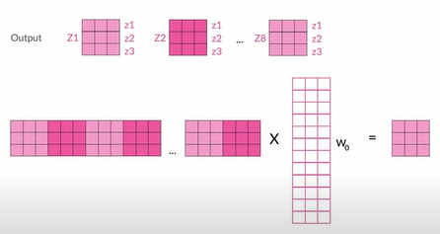

Slide 28
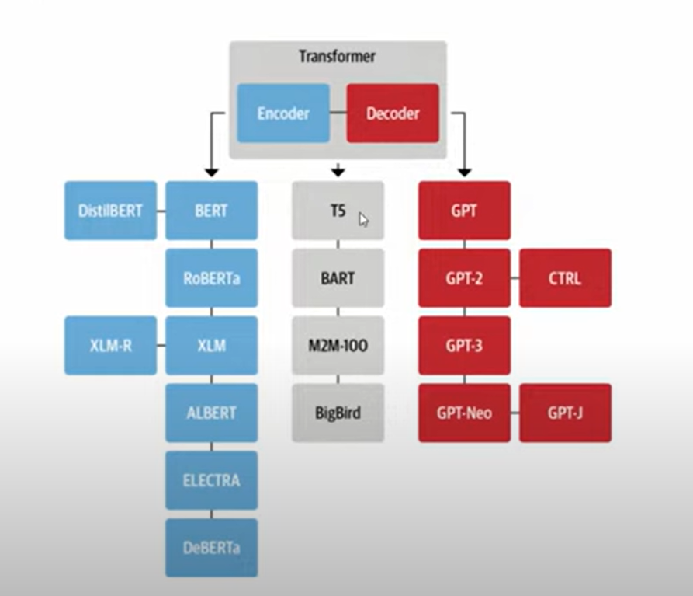

Slide 29
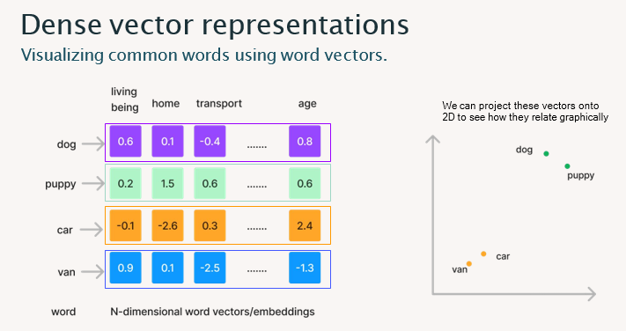

Slide 30
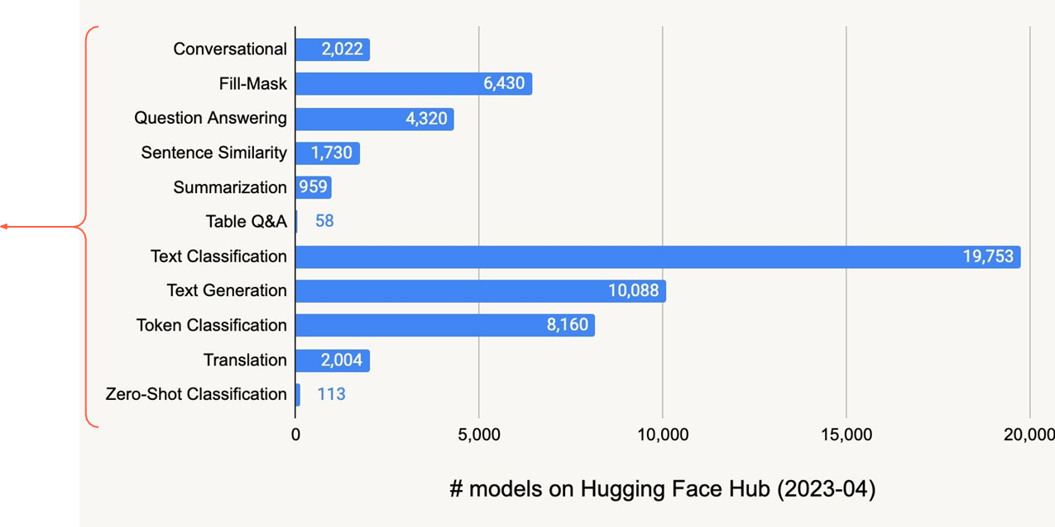
Large LMs are just LMs with transformer architectures, but bigger.
Tokens are the smallest building blocks to convert text to numerical vectors, aka N-dimensional embeddings.

Slide 31
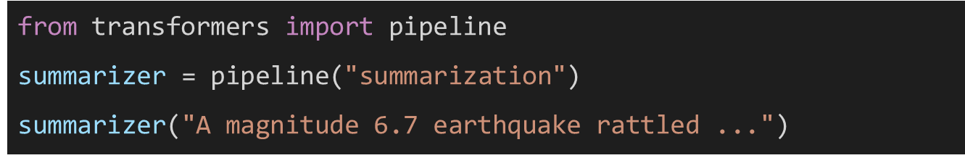
Hugging face == Github for LLM
Summarization
Sentiment analysis
Translation
Zero-shot classiﬁcation
Few-shot learning
Conversation / chat
(Table) Question-answering
Text / token classiﬁcation
Text generation

Slide 32
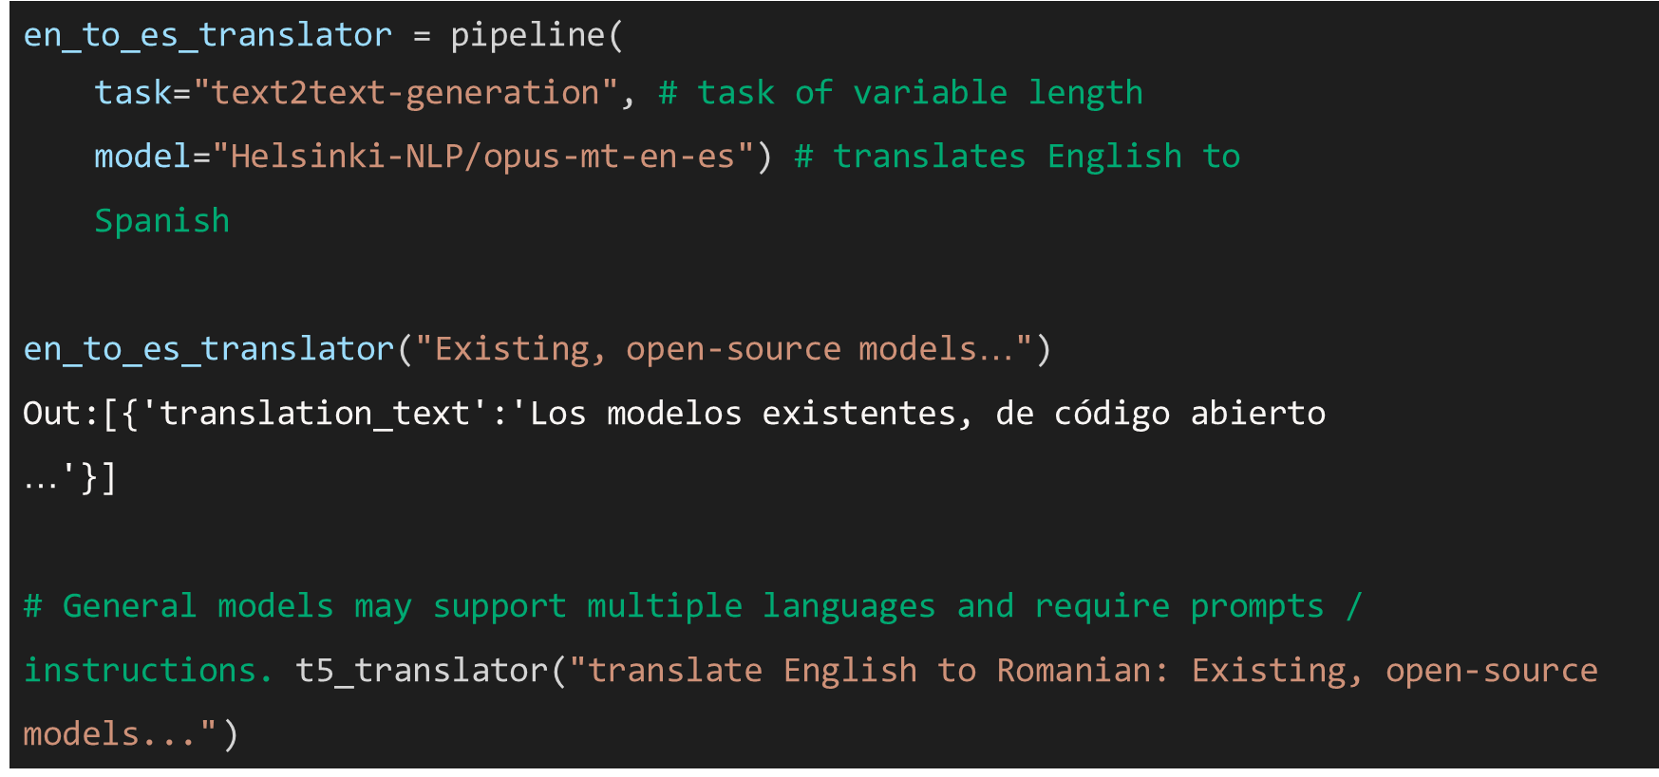

Slide 33
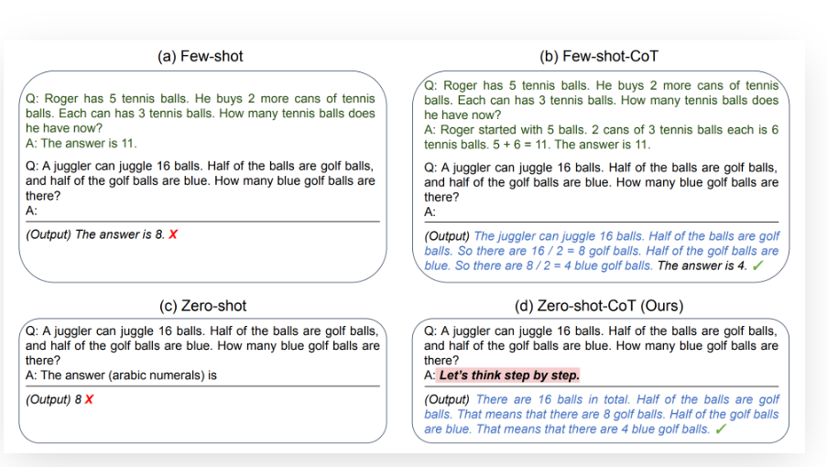
Prompts:
Our entry to interacting with LLMs
Types of prompting:
Zero-shot learning
One-shot learning
Few –shot learning

Slide 34
Embedding's, Vector Databases, and Search

Slide 35
How do language models learn knowledge?
Through model training or ﬁne-tuning
Via model weights
More on ﬁne-tuning in Module 4
Through model inputs
Insert knowledge or context into the input
Ask the LM to incorporate the context in its output
This is what we will cover:
How do we use vectors to search and provide relevant context to LMs?
©2023 Databricks Inc. — All rights reserved

Slide 36



Turn images and audio into vectors too
Data objects Vectors
[0.5, 1.4, -1.3, ….]
Tasks
Object recognition
Scene detection
Product search
Translation
Question Answering
Semantic search
Speech to text
Music transcription
Machinery malfunction
[0.8, 1.4, -2.3, ….]
[1.8, 0.4, -1.5, ….]
©2023 Databricks Inc. — All rights reserved

Slide 37


Use cases of vector databases
Similarity search: text, images, audio
De-duplication
Semantic match, rather than keyword match!
Are electric cars better for the environment?
electric cars climate impact
Example on enhancing product search
Very useful for knowledge-based Q/A
Recommendation engines
Example blog post: Spotify uses vector search to recommend podcast episodes
Environmental impact of electric vehicles
How to cope with the pandemic
dealing with covid ptsd
Finding security threats
Vectorizing virus binaries and ﬁnding anomalies
Dealing with covid anxiety
©2023 Databcks Inc. — All rights reserve

Slide 38
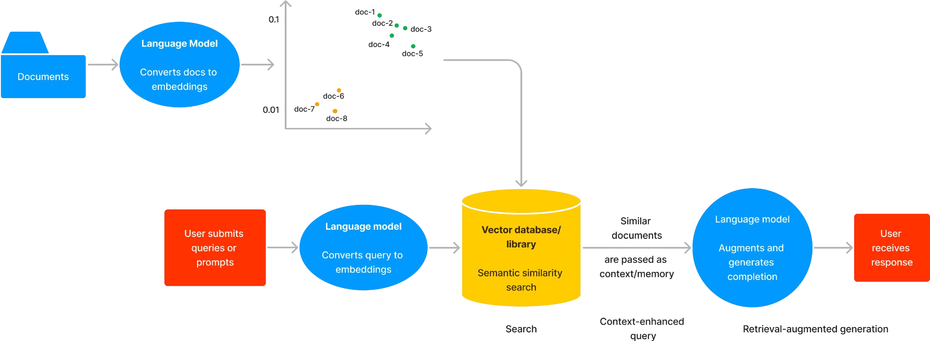
Search and Retrieval-Augmented Generation
The RAG workﬂow
©2023 Databricks Inc. — All rights reserved

Slide 39
How does
vector search work?

Slide 40
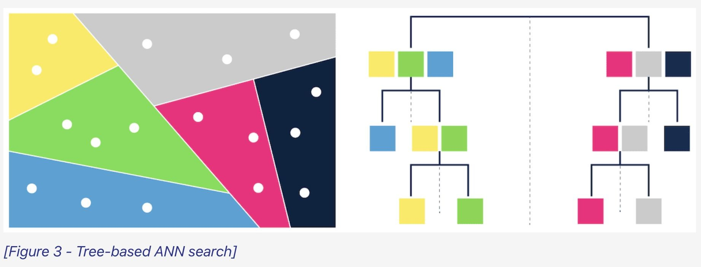
K-nearest neighbors (KNN)
Approximate nearest neighbors (ANN)
Trade accuracy for speed gains
Examples of indexing algorithms:
Tree-based: ANNOY by Spotify
Proximity graphs: HNSW
Clustering: FAISS by Facebook
Hashing: LSH
Vector compression: SCaNN by Google
Vector search strategies

Slide 41
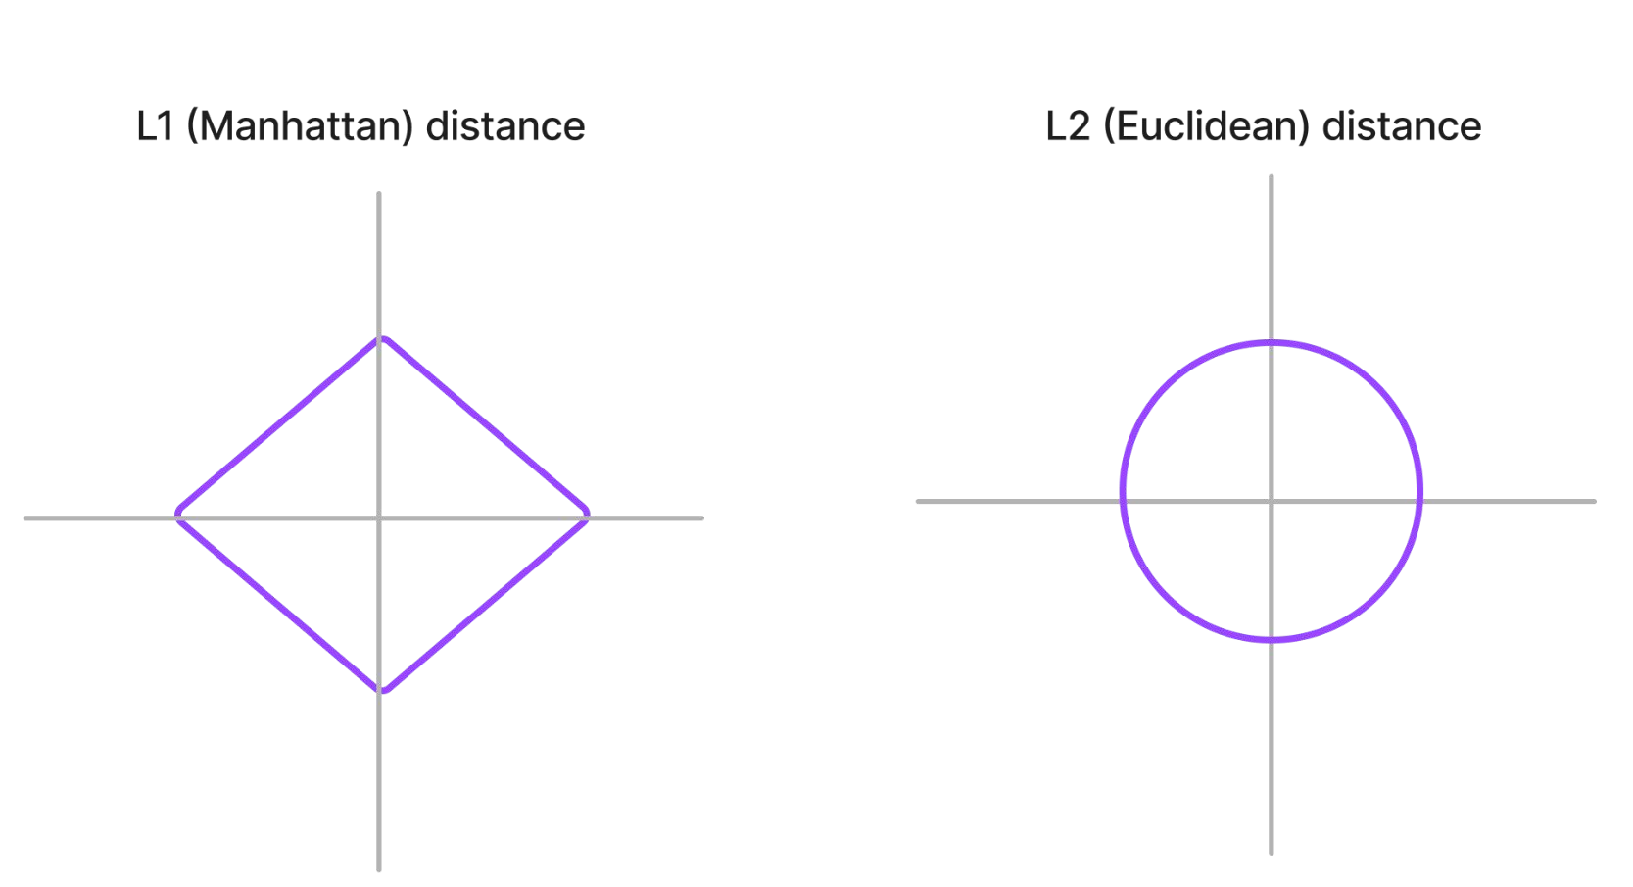
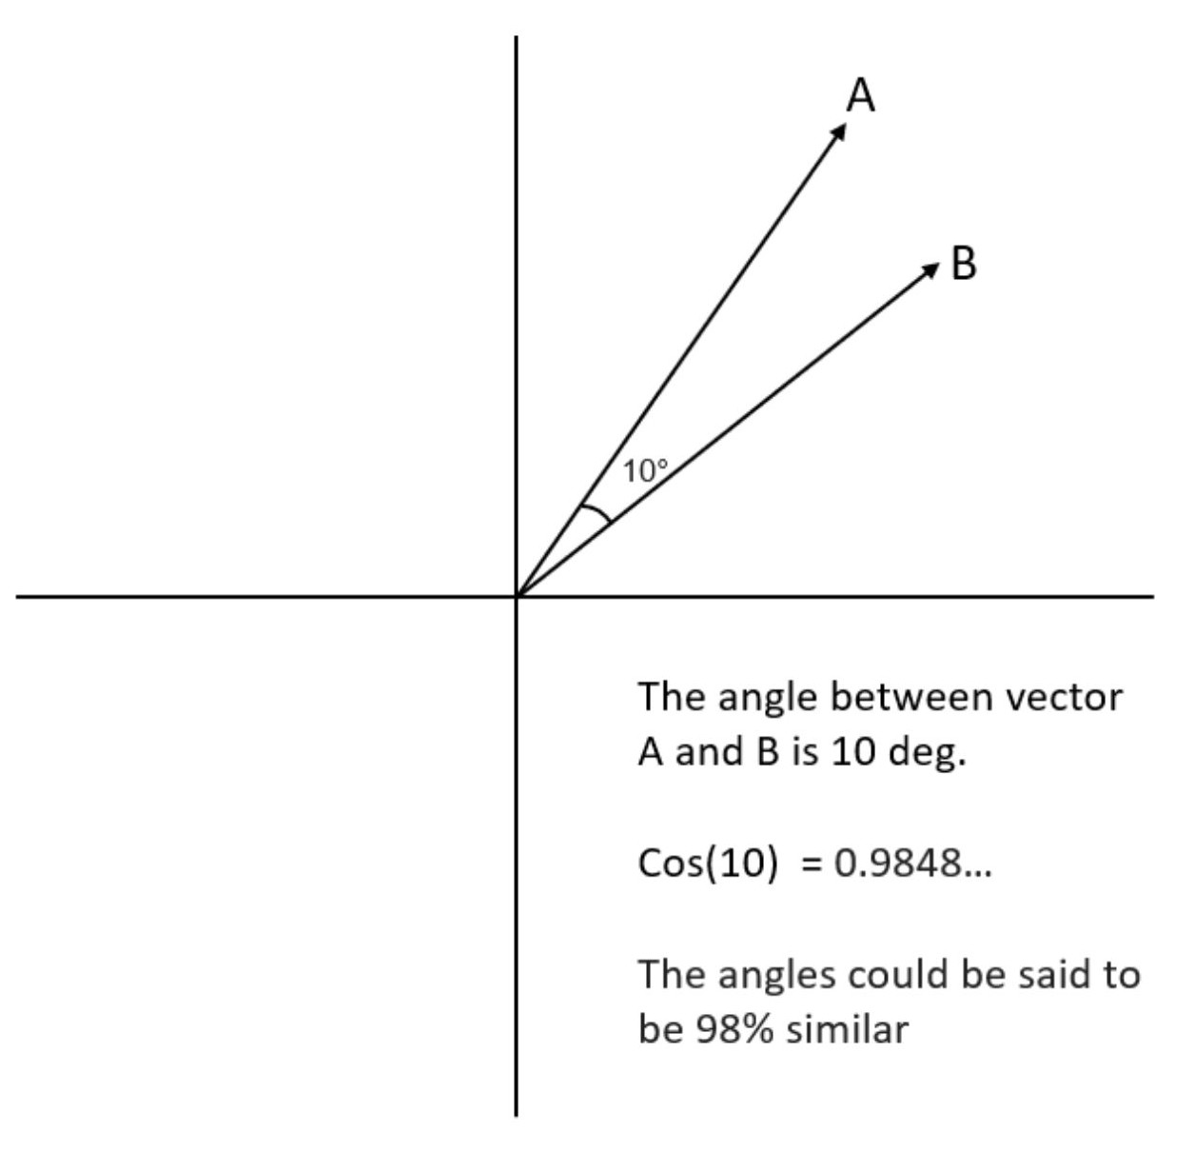
How to measure if 2 vectors are similar?
L2 (Euclidean) and cosine are most popular

Slide 42
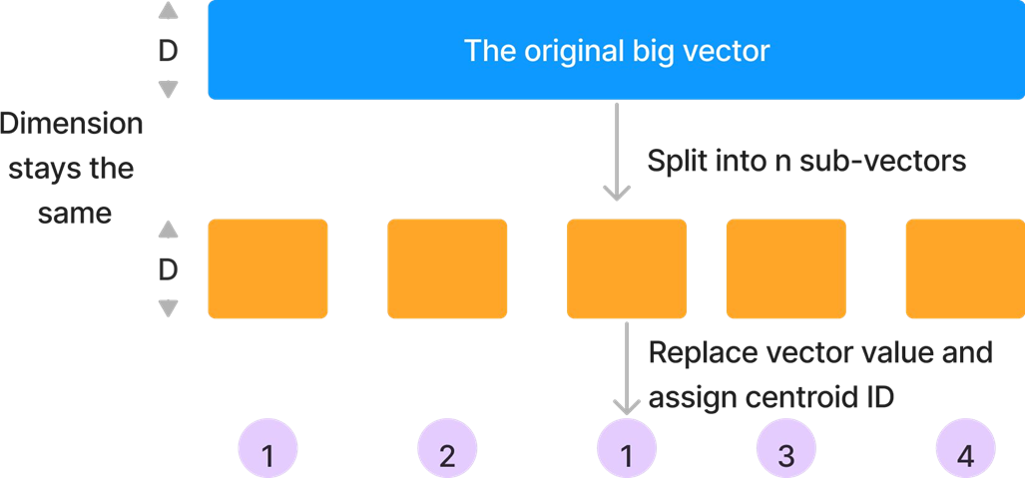
Compressing vectors with Product Quantization
PQ stores vectors with fewer bytes
Quantization = representing vectors to a smaller set of vectors
Naive example: round(8.954521346) = 9
Trade off between recall and memory saving

Slide 43
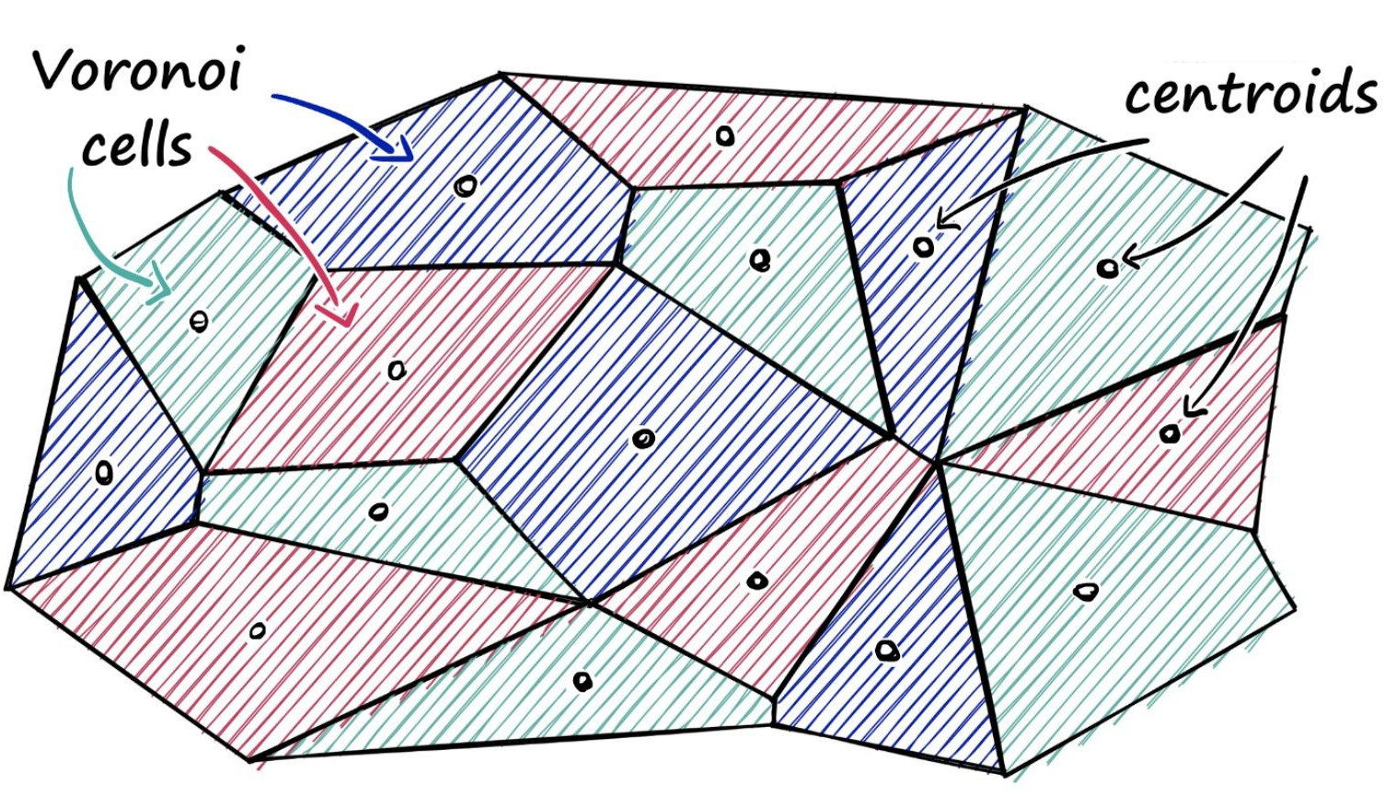
FAISS: Facebook AI Similarity Search
Forms clusters of dense vectors and conducts Product Quantization
Compute Euclidean distance between all points and query vector
Given a query vector, identify which cell it belongs to
Find all other vectors belonging to that cell
Limitation: Not good with sparse vectors (refer to GitHub issue)

Slide 44
Filtering

Slide 45
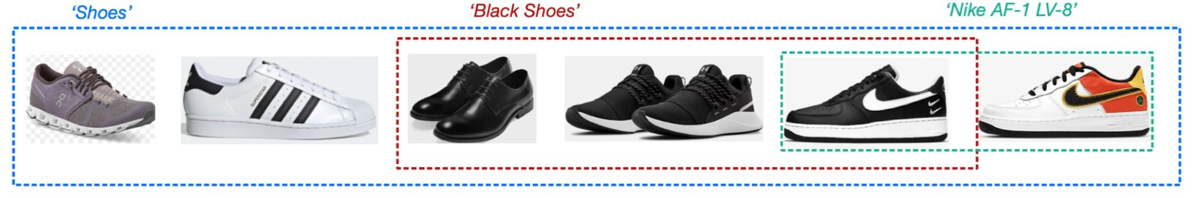
Adding ﬁltering function is hard
I want Nike-only: need an additional metadata index for “Nike”
Types
Source: Pinecone
Post-query
In-query
Pre-query
No one-sized shoe ﬁts all
Different vector databases implement this differently

Slide 46
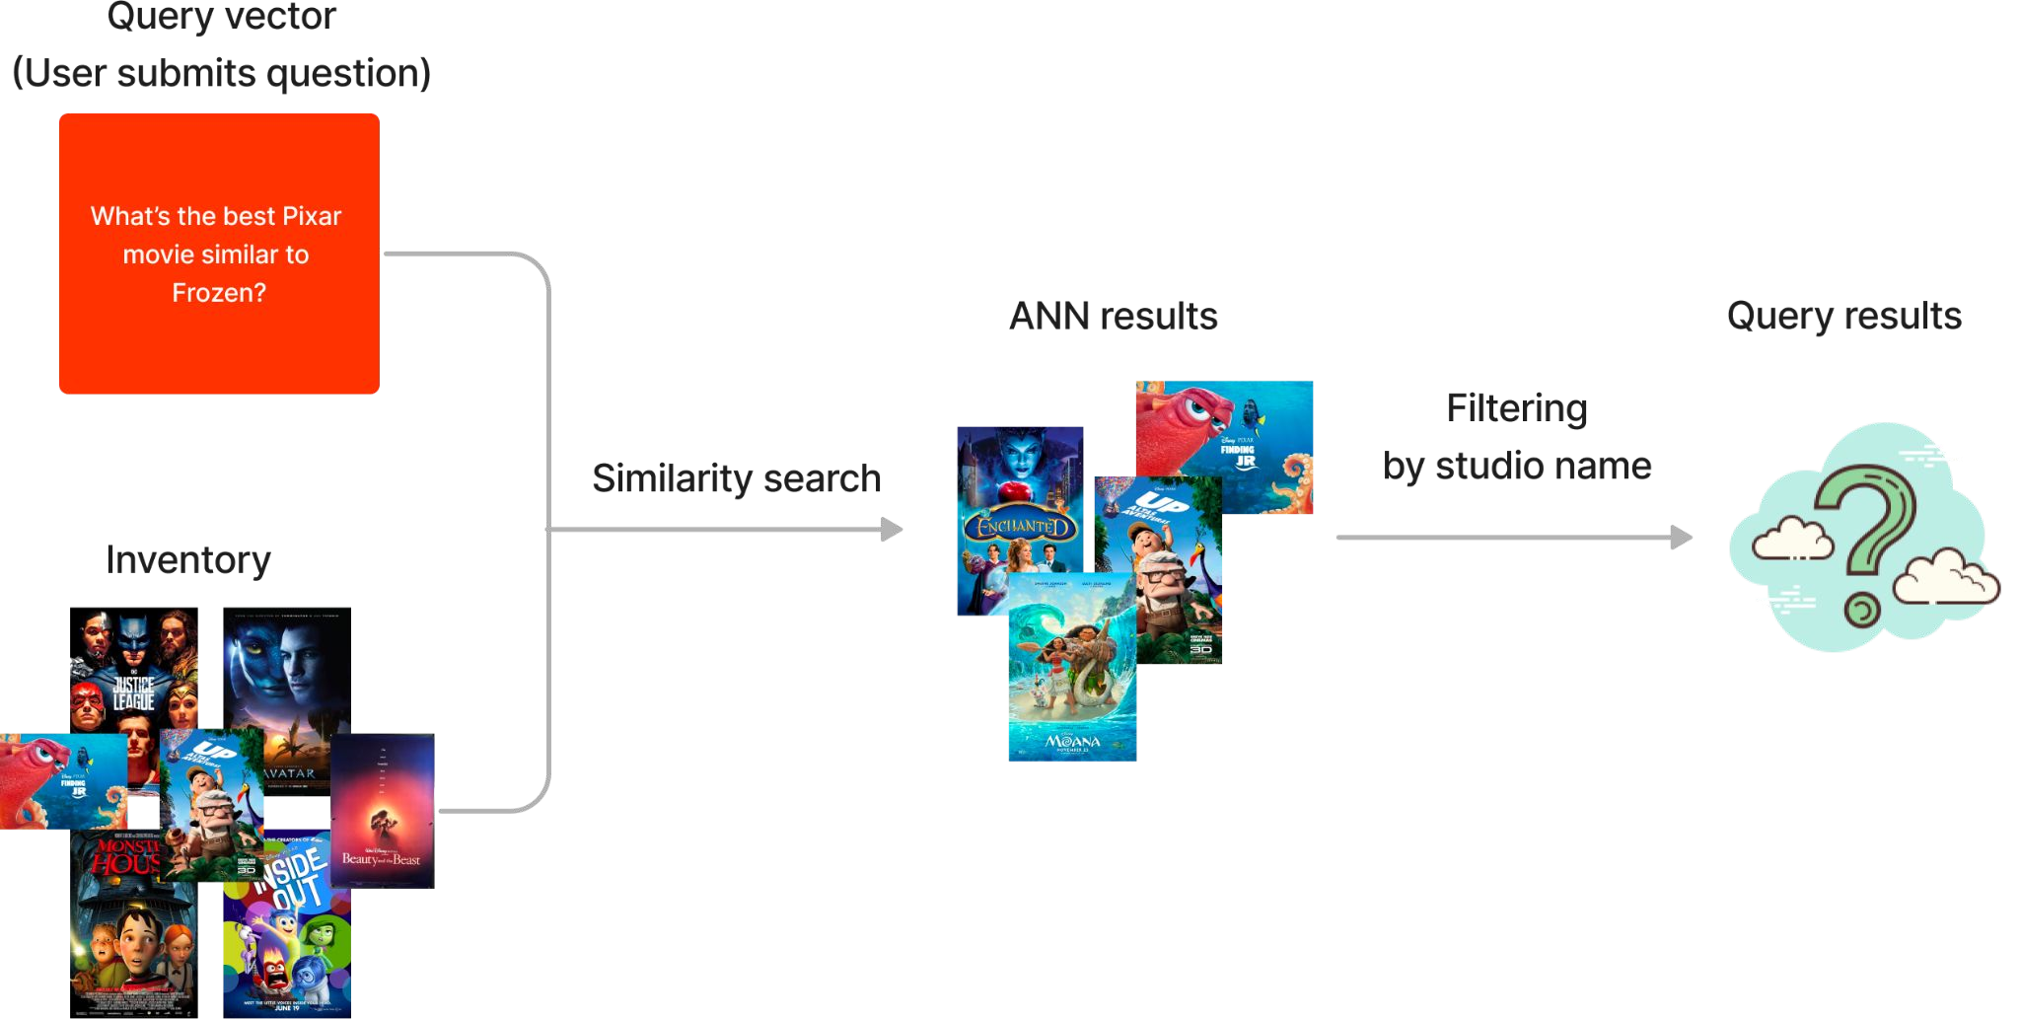

Post-query ﬁltering
Applies ﬁlters to top-k results after user queries
Leverages ANN speed
number of results is highly unpredictable
Maybe no products meet the requirements
©2023 Databricks Inc. — All rights reserved

Slide 47
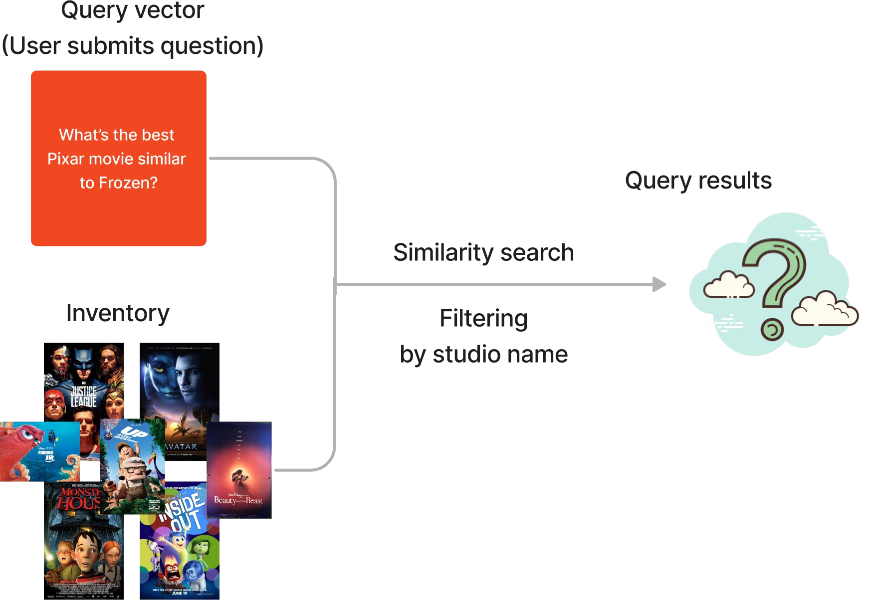
In-query ﬁltering
Compute both product similarity and ﬁlters simultaneously
Product similarity as vectors
Branding as a scalar
Leverages ANN speed
May hit system OOM!
Especially when many ﬁlters are applied
Suitable for row-based data
©2023 Databricks Inc. — All rights reserved

Slide 48
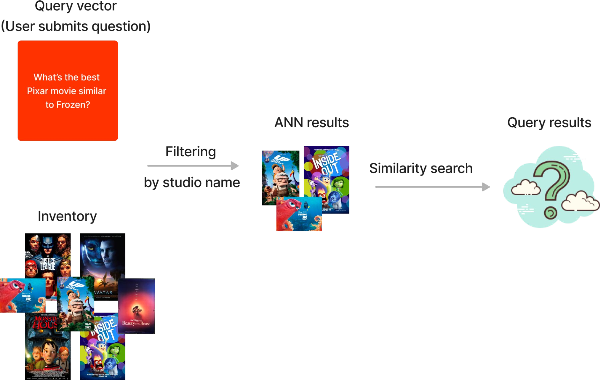
Pre-query ﬁltering
Search for products within a limited scope
All data needs to be ﬁltered == brute force search!
Slows down search
Not as performant as post- or in-query ﬁltering
©2023 Databricks Inc. — All rights reserved

Slide 49
Vector stores
Databases, libraries, plugins

Slide 50
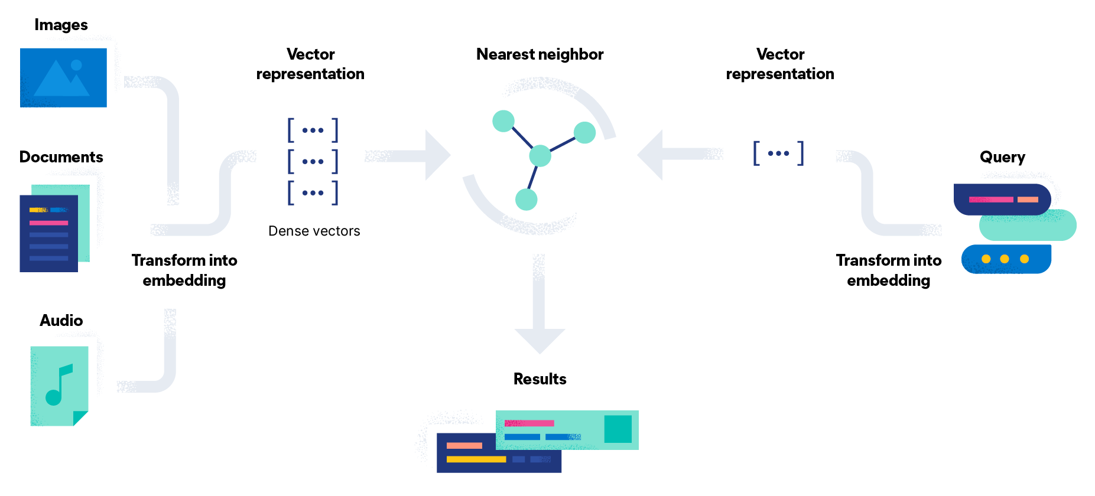
Why are vector database (VDBs) so hot?
Query time and scalability
Specialized, full-ﬂedged databases for unstructured data
Inherit database properties, i.e. Create-Read-Update-Delete (CRUD)
Speed up query search for the closest vectors
Rely on ANN algorithms
Organize embeddings into indices

Slide 51
Popular vector database comparisons
 |  | Released | Billion-scale vector support | Approximate Nearest Neighbor Algorithm | LangChain Integration
Open-Sourced
Chroma | 2022 |  | No | HNSW | Yes
Milvus | 2019 |  | Yes | FAISS, ANNOY, HNSW
Qdrant | 2020 |  | No | HNSW
Redis | 2022 |  | No | HNSW
Weaviate | 2016 |  | No | HNSW
Vespa | 2016 |  | Yes | Modiﬁed HNSW
Not Open-Sourced
Pinecone |  | 2021 | Yes | Proprietary | Yes

Slide 52
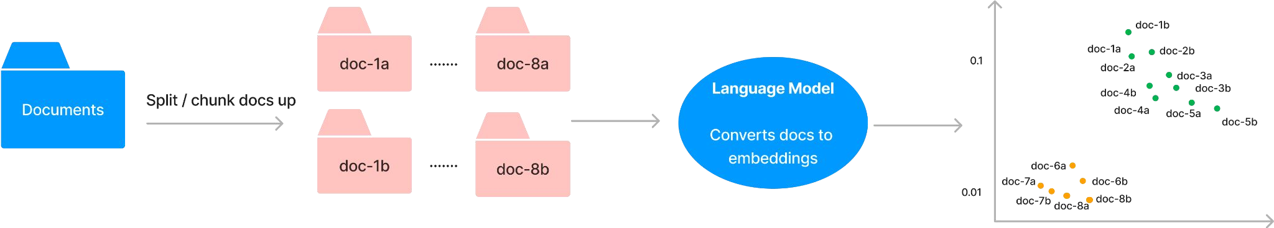
Chunking strategy: Splitting document
Split into paragraphs? Sections?
Chunking strategy determines
How relevant is the context to the prompt?
How much context/chunks can I ﬁt within the model’s token limit?
Do I need to pass this output to the next LLM? (Module 3: Chaining LLMs into a workﬂow)
Splitting 1 doc into smaller docs = 1 doc can produce N vectors of M tokens
©2023 Databricks Inc. — All rights reserved

Slide 53
Over-view of vector store and searches
Vector stores are useful when you need context augmentation.
Vector search is all about calculating vector similarities or distances.
A vector database is a regular database with out-of-the-box search capabilities.
Vector databases are useful if you need database properties, have big data, and need low latency.
Select the right embedding model for your data.
Iterate upon document splitting/chunking strategy

Slide 54
Limitations of LLM
Most suitable for single task, but not for multiple tasks..

Slide 55



Tasks: Single interaction with an LLM
Direct LLM calls are just part of a full task/application workﬂow
se
LLM Ttasks vs LLM-based Workﬂows
Typical applications are more than just a prompt-response system.
Task
Task
Task
Task
Workflow Initiated
Task
Workﬂow Completed
Workfiow: Applications with more than a single interaction
Task
End-to-end workﬂow
ved

